Slide 1
Beneficial Resources
Inspired by the Syllabus
Mary Stewart Anderson
EDSP5311: Diagnostic and Prescriptive Teaching for Exceptional Children
Dr. Reed
Houston Baptist University

Slide 2
Project Overview and Plan
There were 48 online links provided in the syllabus to accompany our reading and chapter projects.
I provided you with a review of each one and highlights of the main ideas and topics.
I will review with you what I found to be the most helpful links under each topic.
I will also introduce you to a few extra resources that I found beneficial.

Slide 3
Topics (from syllabus and in syllabus order)
Prescriptive Teaching, Perceptions of Disability, History
Collaboration, RTI + Prereferral Data, CBM
Learning Characteristics, Executive Functions, Metacognition
Classroom Management, FBA/BIP, Behavior
Assessment – What it is, Formal/Informal, the what and how
Linking Assessment with Instruction, Individual Needs + TEKS
Designing, Delivering, and Modifying Instruction, Grading
Written Expressing, PLAAFP, IEPs, Assessment Decisions
Reading Instruction
Math Instruction
Integrating Technology, Evaluating Instruction
Data-Based ARD Committee Decision Making, STAAR

Slide 4
What Do You See? Perceptions of Disability – The IRIS Center, Vanderbilt Peabody College
Online module involving pictures, videos, activities, and response questions
Objectives:
Societal views can shape beliefs about people with disabilities
Recognize myths and misconceptions about disabilities
Understand how perceptions impact people with disabilities in positive and negative ways
Introduces you to people who have disabilities and talks of their accomplishments
Poem written by the mother of a child with a disability.
A closer look at how people with disabilities are portrayed in film and in literature.
Myths and Facts about people with disabilities
Biography-writing activity
Inspiration Porn and the Objectification
of Disability: Stella Young
Activity: A closer look at how disabilities are portrayed in books and film
Prescriptive Teaching, Perceptions of Disability, History

Slide 5
Response to Intervention – Intervention Central, Resources
Provides teachers, schools, and districts with free resources to help struggling learners and implements RTI and attain Common Core Standards
Information on learning contracts, describing academic problems clearly and accurately, using praise in the classroom, cover-copy-compare math fact and spelling intervention, conducting classroom discussions, mystery motivator rewards and behavior management strategies, and large and small group behavior management procedures
Examples of tools they provide:
Academic intervention planner for struggling students
Behavior intervention planner
Behavior rating scales report card maker
Dolch word list fluency generator
Learning disability accommodations finder
Letter name fluency generator
Math worksheet generators
Reading fluency passage generator
Self-check behavior checklist maker
Test of reading comprehension – maze passage generator
Writing probe generator
Oral Reading Fluency Passage Generator
Tortoise and the Hare
Collaboration, RTI + Prereferral Data, CBM

Slide 6
Using Metacognition and Learning Styles to Create Self-Directed Learners – Steven Shannon, Research Report
The purpose of this action research project was to help students become self-directed learners by determining what metacognitive strategies would be the most effective for a student’s specific learning styles.
Strategies: predicting outcomes, evaluating work, questioning by the teacher, self-assessing, self-questioning, selecting strategies, using discourse, critiquing, and revising
Learning styles:
print – seeing printed or written words (notes, red + recall, writing, seeing)
aural – listening (lectures, podcasts, audio, etc.)
visual – seeing visual depictions (demonstrations, visual media, pictures, slides, graphs)
interactive – verbalization (group discussions, question and answer sessions, people as a sounding board)
haptic – sense of touch or grasp (hands-on, doodling, manipulation)
kinesthetic – whole body movement (physical response activities, direct involvement)
olfactory – sense of smell and taste (enhances learning with smells)
Learning Style | Preferred Metacognitive Strategy
Kinesthetic | Strategies where they were given direct involvement
Interactive | Critiquing and revising
Haptic | Selecting strategies where they could have “hands-on” contact with the study
Visual | Self-questioning and predicting outcomes using a variety of visual methods
Print | Self-assessing; shied away from discussing findings
Aural | Questioning by the teacher
Learning Characteristics, Executive Functions, Metacognition

Slide 7
Texas Behavior Support – Positive Behavior Intervention and Supports
The goal of the TBS Network is to create a system for PBIS for students with disabilities and all students attending Texas public schools. The TBS Network adopted PBIS as its philosophical foundation and supports all three tiers of the model including school-wide and classroom
Sponsored by TEA and region 4
Texas Behavior Support Initiative
state-level training mandated by Senate Bill 1196 and the Texas Administrative Code. The TBSI training is designed to provide foundational knowledge for the use of positive behavior interventions and supports for all students including those with disabilities
TBSI meets legislative requirements related to procedures for the use of restraint and time-out and provides a framework for sharing a wide range of foundation-level behavior strategies and prevention-based school-wide, classroom, and individual interventions
TBSI Modules and Certificates
Classroom Management, FBA/BIP, Behavior

Slide 8
Assessment and Progress Monitoring – Dynamic Indicators of Basic English Language Skills (DIBELS), University of Oregon
Offers materials for students from K – 6th grade
Assesses initial sound fluency, letter naming fluency, phoneme segmentation fluency, nonsense word fluency, word use fluency, oral reading fluency, and retell fluency
Assessment and progress monitoring, free and effective, leveled
https://dibels.uoregon.edu/assessment/index/materialdownload?agree=true
See DIBELS material
Assessment – What it is, Formal/Informal, the what and how

Slide 9
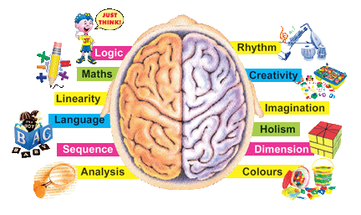
Universal Design for Learning *not from the syllabus
https://www.youtube.com/watch?v=aaweXw03kQI
Whole Brain Teaching: Grade 1 Classroom
Whole Brain Teaching is based on the idea that students learn the most when they are having fun.
Humor and games are used to increase the number of times students repeat core information and practice basic skills.
Classes are highly disciplined and tightly organized because students have more fun following rules than ignoring them.
Free seminars and downloads are located on the website.
“Teaching is a movement, not a business.”
Whole Brain Teaching, 2015
https://www.youtube.com/watch?v=zQd0aZ5RNzw
Whole Brain Teaching, High School – The Basics
Linking Assessment with Instruction, Individual Needs + TEKS

Slide 10
SRSD: Using Learning Strategies to Enhance Student Learning – The IRIS Center, Vanderbilt Peabody College
Objectives
Describe what a strategy is
Understand what strategy instruction is and what its benefits are
List the steps used to implement strategy instruction
Understand how self-regulation improves the use of a strategy
Strategy – a series of steps that we use to more quickly of effectively perform a specific task
SRSD Model
A scientifically validated framework for explicitly teaching academic strategies to students, SRSD incorporates steps that have been shown to be critical is students are to learn how to effectively use academic strategies
Six Stages: develop background knowledge, discuss it, model it, memorize it, support it, establish independent practice
Self-regulation
Self-regulation instruction helps students to learn strategies that can improve their self-control and performance of their own manner of learning
Self-regulation strategies are often taught in tandem with academic strategies and can improve student outcomes
These evidence-based strategies:
reduce disruptive problems in the classroom
empower students by allowing them to reinforce their own behavior
are simple, inexpensive, and can be taught to students in all grades
Designing, Delivering, and Modifying Instruction, Grading

Slide 11
Links - Texas Education Agency
Data and Reports
A variety of reports and data available about special education programs and students
Dispute Resolution Process: three routes for resolving the dispute: Mediation, Complaint Resolution, Due Process Hearing
Parent and Family Resources
Services and Resources available for the families of children served in special education programs
Community Parent Resource Centers
Education Service center Technical Assistance
Guidance on ARD Guide Production and Required Dissemination
Guidance on Revocation of Parental Consent for Special Education Services
Guidance on Procedural Safeguards Production and Required Dissemination
Parent Training and Information (PTI) Projects
Programs and Services
Special Education in Texas A – Z Index
Curriculum and Instructional Materials
Services for Texas Students with Disabilities Ages 3 – 5 Significant Disproportionality Special Education Funding Special Education Rules and Regulations State Guidance State Rules Student Handbook Statement Texas Continuous Improvement Process Texas Special Education Continuing Advisory Committee | Extended School Year Services IEP Model Form Individualized Education Programs Facilitation Nonpublic Day School Programs Report Reading and Special Education Resources to Support Student Access to the General Curriculum Response to Intervention (RTI) School Healthy and Related Services Sensory Impairment
Written Expressing, PLAAFP, IEPs, Assessment Decisions

Slide 12
Writing Measurable IEP Goals and Objectives by Barbara Bateman and Cynthia Herr
Part I: Goals, Objectives, Benchmarks
IDEA 2004
Measurability
Specificity
Myths
Questions/Answers
Part II: Writing Goals and Objectives
The Writing Process
Present Levels of Performance
Writing Goals, Objectives, and Benchmarks
Moving the PLOP to the Goal
Examples
Part III: Sample Best Practice PLOPs, Objectives, Goals
Samples
Matrix
http://www.wrightslaw.com/store/bb.iep.html
Written Expressing, PLAAFP, IEPs, Assessment Decisions cont’d

Slide 13
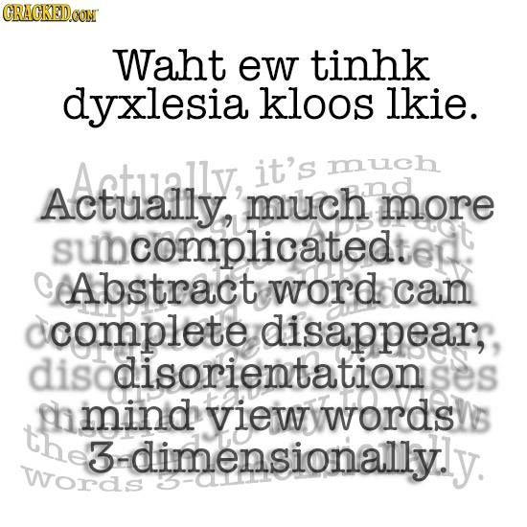
Understanding Dyslexia – Understood.com
What is dyslexia?
It is not a sign of low intelligence or laziness; it is not due to poor vision
It is a common condition that affects the way the brain processes written and spoken language
It is primarily associated with trouble reading; “reading disorder” or “reading disability”
it is a lifelong condition
What are the symptoms of dyslexia?
symptoms look different from person to person; some kids have trouble with reading and spelling others have trouble with writing or telling the different between left and right
some don’t struggle with early reading and writing, but have trouble with complex language skills (grammar, comprehension, in-depth writing) later on.
sometimes people have trouble expressing themselves clearly
Signs look different at different ages.
What skills are affected by dyslexia?
Social Skills, Listening Comprehension, Memory, Navigation, Time management
How is dyslexia diagnosed?
Getting a formal diagnosis requires a team of professionals
Step 1: Get a Medical exam
Step 2: Get a referral to a specialist
Step 3: Put it all together
Key takeaways
Dyslexia is a lifelong condition that affects reading, writing, spelling, and even speaking
Dyslexia is very common and is not a sign of low intelligence
Teaching methods that involve sight, sound, and touch can improve skills significantly
https://www.understood.org/en/tools/through-your-childs-eyes
https://www.understood.org/en/tools/through-your-childs-eyes
Reading Instruction

Slide 14
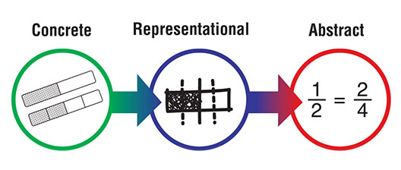
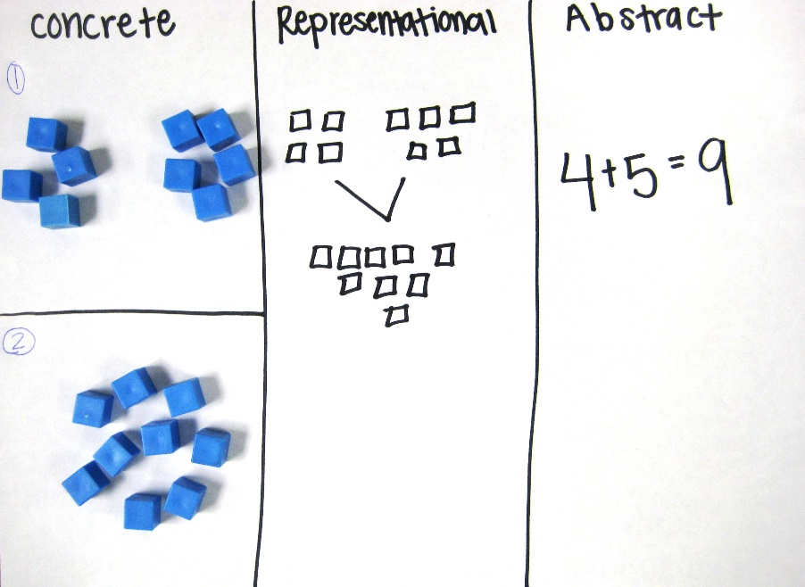
Concrete Representational Abstract – Making Education Fun
A three step approach that has been found to be highly effectives in teaching math concepts.
Step 1: Concrete Stage
Known as the “doing” stage
Involves physically manipulating objects to solve a math problem.
Step 2: Representational (semi-concrete) Stage
Known as the “seeing” stage
Involves using images to represent objects to solve a math problem.
Step 3: Abstract Stage
Known as the “symbolic” stage
Involves using only numbers and symbols to solve a math problem
Video about CRA
https://www.youtube.com/watch?v=0Oa3dZCPeRM
Math Instruction
CRA Activity

Slide 15
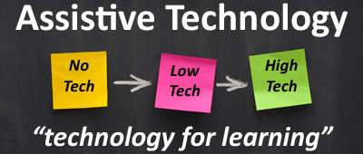
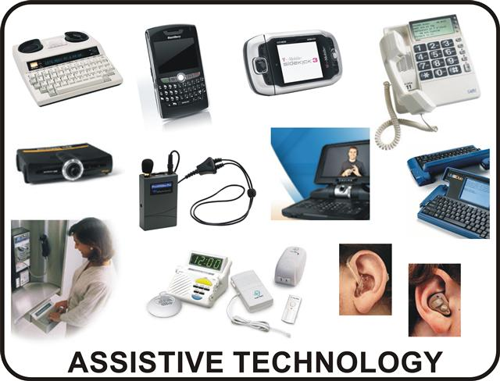
Assistive Technology - PBS
Assistive technology is any device that helps a person with a disability complete a everyday task.
Glasses, crutches, or even a remote control can be a form of assistive technology.
Can be “low-tech” – simple, low-cost (ex: pencil grip)
Can be “high-tech” – something sophisticated (ex: computer)
The federal government recognizes the importance of assistive technology under IDEA. It began being part of the law in 1997.
IDEA states that school districts must consider assistive technology for any child in special education. That means that for any child receiving services, the IEP team must ask if there is a device that will “increase, maintain, or improve functional capabilities” of the child.
If the answer is yes, the school district must provide services:
a qualified evaluator must complete an assistive technology evaluation
if the evaluator recommends a device, it must be acquired
and if you, your child, or the staff in your child’s school need training to use the device, the training must be provided, too.
Assistive Technology Case Studies
Integrating Technology, Evaluating Instruction

Slide 16
Accommodations Resources – Texas Education Agency
Accommodations are changes to materials or procedures that enable students with disabilities or English language learners (ELLs) to participate meaningfully in learning and testing
STAAR Accommodations
Accommodations for Students with Disabilities Taking State Assessments
Linguistic Accommodations for ELLs Participating in the STAAR Program
Accommodations Resources Contact Information Correspondence with Districts PDF Help Reports and Studies Resources for Out-of-District and Out-Of-School examinees Resources for Students and Parents | Resources for Teachers and Administrators Student Assessment a-to-Z Directory Student Success Initiative Test Administration Manuals and Materials Test Security Testing Calendars Texas Assessment Management System
Guide to the ARD Process, Region 18
Data-Based ARD Committee Decision Making, STAAR

Slide 17
What does the teacher say? https://www.youtube.com/watch?v=w_hph89OA8I

Slide 18
References
Acronym Finder. (2015). What does TEKS stand for? Retrieved from http://www.acronymfinder.com/Texas-
Essential-Knowledge-and-Skills-(Texas-educational-standards-for-K_12)-(TEKS).html
Alexander, D. (2015). Writing effective and appropriate IEP goals and objectives for students with
learning disabilities. Retrieved from http://www.brighthubeducation.com/special-ed-law/63909-
basic-examples-of-iep-goals-and-objectives-for-students-with-learning-disabilities/
Anderson, S. [KBYUEleven]. (2012). Aiding a child’s social and emotional development. [Video file]. Retrieved
from https://www.youtube.com/watch?v=3j4FvuNYFqA&spfreload=10
Balanced Reading. (2009). Developing research-based resources for the balanced reading teacher. Retrieved
from http://balancedreading.com/
Bateman, B. D. and Herr, C. M. (2006). Writing measurable IEP goals and objectives. Retrieved from
http://www.attainmentcompany.com/sites/default/files/pdf/sample/WMIEP_Sample.pdf
Beating Dyslexia.com. (2014). Dyslexia treatment. Retrieved from http://www.beatingdyslexia.com/dyslexia-
treatment.html
Biffle, C. (2015). Whole brain teachers of America. Retrieved from http://www.wholebrainteaching.com
/index.php?option=com_k2&view=item&id=135:whole-brain-teachers-of-america&Itemid=105

Slide 19
References cont’d
Blahnik, M. [Innovative Learning Group] (2014). Behavior: As easy as “A-B-C”. [Video file]. Retrieved from
https://www.youtube.com/watch?v=bXLdcS3_Hzw
Buck Institute for Education. (2015). Project based learning: The online resource for PBL. Retrieved from
http://archive.pbl-online.org/
Career Technical Special Populations Training & Resource Education Center. (2012). Universal design for
learning strategies in CTE instruction. Retrieved from http://ctsp.tamu.edu/videos/videos11/
CTSP_2011_001/index.php
Craig, A. P. (2015). Stages of prescriptive teaching. Retrieved from http://www.ehow.com/
list_6648545_stages-prescriptive-teaching.html
Freundlichteaching. [Freundlichteaching]. (2010). Whole brain teaching: Grade 1 classroom. [Video file].
Retrieved from https://www.youtube.com/watch?v=aaweXw03kQI
International Dyslexia Association. (2015). Home page. Retrieved from http://eida.org/
Intervention Central. (2015). Curriculum based measurement warehouse: Reading, math, and other
academic assessments. Retrieved from www.interventioncentral.org

Slide 20
References cont’d
Intervention Central. (2015). Response to Intervention – RTI resources. Retrieved from
www.interventioncentral.org
The IRIS Center for Training Enhancements. (2004). Accommodations: Instructional and testing supports for
students with disabilities. Retrieved from http://iris.peabody.vanderbilt.edu/module/acc/
The IRIS Center for Training Enhancements. (2004). Classroom assessment (part 1): An introduction to
monitoring academic achievement in the classroom. Retrieved from
http://iris.peabody.vanderbilt.edu/module/gpm/
The IRIS Center for Training Enhancements. (2004). Classroom assessment (part 1): An introduction to
monitoring academic achievement in the classroom. Retrieved from
http://iris.peabody.vanderbilt.edu/module/rpm/
The IRIS Center for Training Enhancements. (2004). The pre-referral process: Procedures for supporting
students with academic and behavioral concerns. Retrieved from
http://iris.peabody.vanderbilt.edu/module/preref/
The IRIS Center for Training Enhancements. (2004). Using learning strategies to enhance student learning.
Retrieved from http://iris.peabody.vanderbilt.edu/module/srs/

Slide 21
References cont’d
The IRIS Center for Training Enhancements. (2004). What do you see? Perceptions of disability. Retrieved
from http://iris.peabody.vanderbilt.edu/module/da-5/
Lapkin, E. (2015). Understanding Dyslexia. Retrieved from https://www.understood.org/en/learning-
attention-issues/child-learningdisabilities/dyslexia/understanding-dyslexia
LD Info.com. (2013). Dysgraphia: What it is and what it isn’t. Retrieved from
http://www.ldinfo.com/dysgraphia.htm
LD info.com. (2013). Dyscalculia: What it is and what it isn’t. Retrieved from
http://www.ldinfo.com/dyscalculia.htm
LD Online. (2013). CPI online entry/scoring area rating of executive functioning. Retrieved from
http://www.ldinfo.com/cpi-online.htm
Learning Reviews. (2013). Project based learning ideas, lesson plans, examples, templates. Retrieved from
http://www.learningreviews.com/Project-Based-Learning-Lesson-Plans.html
Mackens. [roxishayne]. (2011). Whole brain teaching, high school – The basics. [Video file]. Retrieved from
https://www.youtube.com/watch?v=zQd0aZ5RNzw

Slide 22
References cont’d
Maryland Learning Links. (2015). Universal design for learning (UDL). Retrieved from
http://marylandlearninglinks.org/950
The National Center for Learning Disabilities. (2012). What is dysgraphia? [Video file]. Retrieved from
https://www.youtube.com/watch?v=jmBg_BvDL-c
The National Center on Accessible Information Technology in Education. (2015). About AccessIT. Retrieved
from http://www.washington.edu/accessit/
National Center on Universal Design for Learning. (2012). Texas. Retrieved from
http://www.udlcenter.org/advocacy/state/texas
Pacer. (2004). Assistive technology case studies worksheet. Retrieved from http://www.pacer.org/C3/
curriculum/session4/handouts/Assistive%20Technology%20Case%20Studies%20Worksheet.pdf
Patino, E. (2015). Understanding dysgraphia. Retrieved from https://www.understood.org/en/learning-
attention-issues/child-learning-disabilities/dysgraphia/understanding-dysgraphia
PBS Parents. (2015). Assistive technology. Retrieved from http://www.pbs.org/parents/education/learning-
disabilities/strategies-for-learning-disabilities/assistive-technology/

Slide 23
References cont’d
Queen, A. [Ashley Queen]. (2013). What does the teacher say? [Video file]. Retrieved from
https://www.youtube.com/watch?v=w_hph89OA8I
Region 18 Education Service Center. (2012). A guide to the admission, review, and dismissal process.
Retrieved from https://framework.esc18.net/Documents/ARD%20Guide%20March2012.pdf
Reading Rockets. (2015). Reading and the brain. Retrieved from
http://www.readingrockets.org/shows/launching/brain
Research-Based Education Strategies & Methods. (2012). Concrete representational abstract (CRA). Retrieved
from https://makingeducationfun.wordpress.com/2012/04/29/concrete-representational-abstract-
cra/
RTI Action Network. (2015). What is RTI? Retrieved from http://www.rtinetwork.org/learn/what/whatisrti
SmartBrief. (2015). Sign up for SmartBrief on special education. Retrieved from
http://www2.smartbrief.com/signupSystem/subscribe.action?pageSequence=1&briefName=specialed
Special Education Advisor. (2010). Brief history of special education legislation. Retrieved from
http://www.specialeducationadvisor.com/special-education-laws/a-brief-history-of-special-education-legislation/

Slide 24
References cont’d
Shannon, S. (2008). Using metacognitive strategies and learning styles to create self-directed learners.
Institute for Learning Styles Journal, 1. Retrieved from http://www.auburn.edu/ academic/
education/ilsrj/Journal%20Volumes/Fall%202008%20Volume%201%20PDFs/Metacogniti
ve%20Strategies%20and%20Learning%20Styles.pdf
Story Arts. (2000). The tortoise and the hare. Retrieved from https://www.storyarts.org/library/aesops/
stories/tortoise.html
TEDxSydney. (2014). Inspiration porn and the objectification of disability: Stella Young. [Video file].
Retrieved from http://www.tedxsydney.com/site/item.cfm?item=A83E0095E6074F5CF9
83ACC0FB69395C
Texas Behavior Support. (2014). Home page. Retrieved from http://www.txbehaviorsupport.org/
default.aspx?name=homepage
Texas Education Agency. (2015). Accommodation resources. Retrieved from
http://tea.texas.gov/student.assessment/accommodations/
Texas Education Agency. (2015). Special education. Retrieved from
http://tea.texas.gov/Curriculum_and_Instructional_Programs/Special_Education/

Slide 25
References cont’d
Texas Education Agency. (2015). Special education in Texas a-z index. Retrieved from
http://tea.texas.gov/index2.aspx?id=2147491399
Texas Education Agency. (2010). Texas read source. Retrieved from
http://www.texasreadsource.org/PDSRIWebApp/jsp/index.jsp
Texas Project First. (n.d.). What matters to parents. Retrieved from http://www.texasprojectfirst.org/
Timme, K. J. [Kiera Jay Timme]. (2014). Concrete-representational-abstract instructional model. [Video file].
Retrieved from https://www.youtube.com/watch?v=0Oa3dZCPeRM
University of Oregon. (2015). Dynamic indicators of basic English literacy skills 6th edition. Retrieved from
https://dibels.uoregon.edu/assessment/index/materialdownload?agree=true
University of Washington. (2015). The National Center on Accessible Information Technology in
Education. Retrieved from http://www.washington.edu/accessit/
Wessling, S. B. [Sarah Brown Wessling]. (2015). Strategies for student-centered discussion. [Video file].
Retrieved from https://www.teachingchannel.org/videos/strategies-for-student-centered-discussion

